Slide 1
shanghai
rapidesign
2015
年
工作发展计划规划
POWERPOINT
Shanghai Rapidesign Advertising Co.,ltd, http://www.rapidesign.cn, http://www.rapidppt.com, 4006018802.

Slide 2
shanghai
rapidesign
目录
Contents
1.点击添加标题
Add a title
2.点击添加标题
Add a title
3.点击添加标题
Add a title
4.点击添加标题
Add a title
5.点击添加标题
Add a title

Slide 3
shanghai
rapidesign
目录
Contents
1.点击添加标题
Add a title
2.点击添加标题
Add a title
3.点击添加标题
Add a title
4.点击添加标题
Add a title
5.点击添加标题
Add a title

Slide 4

shanghai
1.点击添加标题
Add a title
rapidesign
上海锐普广告有限公司是中国第一家精品PPT设计机构。拥有国内顶尖的PPT制作技术、顶级的PPT设计团队，坚持精益求精、拒绝平庸的做事精神，帮助您实现美观、精致、严谨、动感的PPT展示效果，让您的PPT创造卓越价值
RAPIDPPT, the leader of professional PPT designer in China.
5years of making professional PPT, 500 case studies for the classical PPT, make sure you will be satisfied. ……RAPIDPPT differs from the traditional production model, and create a new PPT experience.

Slide 5
shanghai
1.点击添加标题
Add a title
rapidesign
1
1
1
1
2
3
点击添加标题
Add a title
点击添加标题
上海锐普广告有限公司是中国第一家精品PPT设计机构。拥有国内顶尖的PPT制作技术、顶级的PPT设计团队，坚持精益求精
5years of making professional PPT, 500 case studies for the classical PPT, make sure you will be satisfied
上海锐普广告有限公司是中国第一家精品PPT设计机构。拥有国内顶尖的PPT制作技术、顶级的PPT设计团队，坚持精益求精

Slide 6



shanghai
1.点击添加标题
Add a title
rapidesign
1
1
1
1
2
3
添加标题
Add a title
添加标题
拥有国内顶尖的PPT制作技术、顶级的PPT设计团队，坚持精益求精
5years of making professional PPT, 500 case studies for the classical PPT.
拥有国内顶尖的PPT制作技术、顶级的PPT设计团队，坚持精益求精

Slide 7






shanghai
1.点击添加标题
Add a title
rapidesign
点击添加标题
Add a title
上海锐普广告有限公司是中国第一家精品PPT设计机构。拥有国内顶尖的PPT制作技术、顶级的PPT设计团队，坚持精益求精、拒绝平庸的做事精神，帮助您实现美观、精致、严谨、动感的PPT展示效果，让您的PPT创造卓越价值
RAPIDPPT, the leader of professional PPT designer in China.
5years of making professional PPT, 500 case studies for the classical PPT, make sure you will be satisfied.
RAPIDPPT differs from the traditional production model, and create a new PPT experience.

Slide 8
shanghai
1.点击添加标题
Add a title
rapidesign
点击添加内容
上海锐普广告有限公司是中国第一家精品PPT设计机构。拥有国内顶尖的PPT制作技术、顶级的PPT设计团队，坚持精益求精、拒绝平庸的做事精神，帮助您实现美观、精致、严谨、动感的PPT展示效果，让您的PPT创造卓越价值
Add content
5years of making professional PPT, 500 case studies for the classical PPT, make sure you will be satisfied. ……RAPIDPPT differs from the traditional production model, and create a new PPT experience.
?
点击添加内容

Slide 9

shanghai
rapidesign
目录
Contents
1.点击添加标题
Add a title
2.点击添加标题
Add a title
3.点击添加标题
Add a title
4.点击添加标题
Add a title
5.点击添加标题
Add a title

Slide 10
shanghai
2.点击添加标题
Add a title
rapidesign
点击添加标题
Add a title
上海锐普广告有限公司是中国第一家精品PPT设计机构。拥有国内顶尖的PPT制作技术、顶级的PPT设计团队，坚持精益求精、拒绝平庸的做事精神，帮助您实现美观、精致、严谨、动感的PPT展示效果，让您的PPT创造卓越价值
RAPIDPPT, the leader of professional PPT designer in China.
5years of making professional PPT, 500 case studies for the classical PPT, make sure you will be satisfied.
RAPIDPPT differs from the traditional production model, and create a new PPT experience.

Slide 11

shanghai
2.点击添加标题
Add a title
rapidesign
拥有国内顶尖的PPT制作技术、顶级的PPT设计团队，坚持精益求精、拒绝平庸的做事精神
帮助您实现美观、精致、严谨、动感的PPT展示效果，让您的PPT创造卓越价值
RAPIDPPT differs from the traditional production model, and create a new PPT experience.
5years of making professional PPT, 500 case studies for the classical PPT, make sure you will be satisfied.

Slide 12
shanghai
2.点击添加标题
Add a title
rapidesign
添加标题
Add a title
添加内容
Add content
Add content
添加内容
拥有国内顶尖的PPT制作技术、顶级的PPT设计团队，坚持精益求精、拒绝平庸的做事精神
帮助您实现美观、精致、严谨、动感的PPT展示效果，让您的PPT创造卓越价值
RAPIDPPT differs from the traditional production model, and create a new PPT experience.
5years of making professional PPT, 500 case studies for the classical PPT.

Slide 13

shanghai
2.点击添加标题
Add a title
rapidesign
添加标题 Add a title
RAPIDPPT, the leader of professional PPT designer in China.
5years of making professional PPT, 500 case studies for the classical PPT, make sure you will be satisfied. ……RAPIDPPT differs from the traditional production model, and create a new PPT experience.
www.rapidppt.com

Slide 14
shanghai
rapidesign
目录
Contents
1.点击添加标题
Add a title
2.点击添加标题
Add a title
3.点击添加标题
Add a title
4.点击添加标题
Add a title
5.点击添加标题
Add a title

Slide 15
shanghai
3.点击添加标题
Add a title
rapidesign
点击添加标题
拥有国内顶尖的PPT制作技术、顶级的PPT设计团队，坚持精益求精、拒绝平庸的做事精神，帮助您实现美观、精致、严谨、动感的PPT展示效果，让您的PPT创造卓越价值
Add a title
Add a title
Add a title
500 case studies for the classical PPT, make sure you will be satisfied. ……RAPIDPPT differs from the traditional production model, and create a new PPT experience.
Add a title
Add a title

Slide 16

shanghai
3.点击添加标题
Add a title
rapidesign
上海锐普广告有限公司是中国第一家精品PPT设计机构。拥有国内顶尖的PPT制作技术、顶级的PPT设计团队，坚持精益求精、拒绝平庸的做事精神，帮助您实现美观、精致、严谨、动感的PPT展示效果，让您的PPT创造卓越价值
5years of making professional PPT, 500 case studies for the classical PPT, make sure you will be satisfied. ……RAPIDPPT differs from the traditional production model, and create a new PPT experience.

Slide 17
shanghai
3.点击添加标题
Add a title
rapidesign
65%
添加标题
35%
Add a title
89%
添加标题
上海锐普广告有限公司是中国第一家精品PPT设计机构

Slide 18

Add a title
RAPIDPPT, the leader of professional PPT designer in China.
5years of making professional PPT, 500 case studies for the classical PPT, make sure you will be satisfied. ……RAPIDPPT differs from the traditional production model, and create a new PPT experience.
Add a title
RAPIDPPT, the leader of professional PPT designer in China.
5years of making professional PPT, 500 case studies for the classical PPT, make sure you will be satisfied. ……RAPIDPPT differs from the traditional production model, and create a new PPT experience.

Slide 19
shanghai
3.点击添加标题
Add a title
rapidesign
添加标题
点击添加标题
Add a title
拥有国内顶尖的PPT制作技术、顶级的PPT设计团队，坚持精益求精、拒绝平庸的做事精神，帮助您实现美观、精致、严谨、动感的PPT展示效果，让您的PPT创造卓越价值
Add a title
5years of making professional PPT, 500 case studies for the classical PPT, make sure you will be satisfied. ……RAPIDPPT differs from the traditional production model, and create a new PPT experience.

Slide 20
shanghai
rapidesign
目录
Contents
1.点击添加标题
Add a title
2.点击添加标题
Add a title
3.点击添加标题
Add a title
4.点击添加标题
Add a title
5.点击添加标题
Add a title

Slide 21
shanghai
4.点击添加标题
Add a title
rapidesign
点击添加内容
Add content
点击添加内容
上海锐普广告有限公司是中国第一家精品PPT设计机构。拥有国内顶尖的PPT制作技术、顶级的PPT设计团队，坚持精益求精、拒绝平庸的做事精神，帮助您实现美观、精致、严谨、动感的PPT展示效果，让您的PPT创造卓越价值
点击添加标题
5years of making professional PPT, 500 case studies for the classical PPT, make sure you will be satisfied. ……RAPIDPPT differs from the traditional production model, and create a new PPT experience.

Slide 22

shanghai
4.点击添加标题
Add a title
rapidesign
上海锐普广告有限公司是中国第一家精品PPT设计机构。拥有国内顶尖的PPT制作技术、顶级的PPT设计团队，坚持精益求精、拒绝平庸的做事精神，帮助您实现美观、精致、严谨、动感的PPT展示效果，让您的PPT创造卓越价值

Slide 23
shanghai
4.点击添加标题
Add a title
rapidesign
点击添加标题
Add a title
添加标题
Add a title
添加标题
Add a title
Add content
Add content
Add content
Add content
Add content
添加内容
Add content
添加内容
拥有国内顶尖的PPT制作技术、顶级的PPT设计团队，坚持精益求精、拒绝平庸的做事精神，帮助您实现美观、精致、严谨、动感的PPT展示效果，让您的PPT创造卓越价值
5years of making professional PPT, 500 case studies for the classical PPT, make sure you will be satisfied. ……RAPIDPPT differs from the traditional production model, and create a new PPT experience.

Slide 24

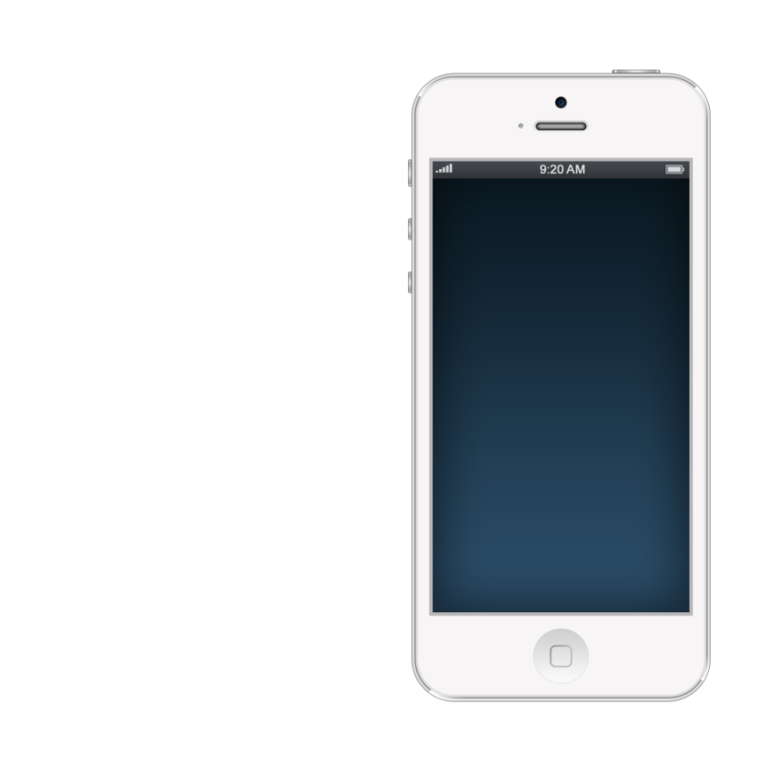
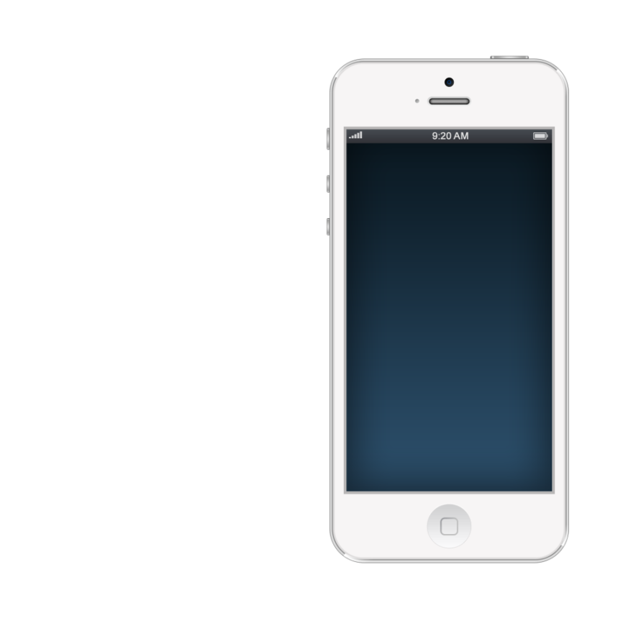


shanghai
4.点击添加标题
Add a title
rapidesign
添加标题
Add a title
拥有国内顶尖的PPT制作技术、顶级的PPT设计团队，坚持精益求精
5years of making professional PPT, 500 case studies for the classical PPT.

Slide 25
shanghai
rapidesign
目录
Contents
1.点击添加标题
Add a title
2.点击添加标题
Add a title
3.点击添加标题
Add a title
4.点击添加标题
Add a title
5.点击添加标题
Add a title

Slide 26



shanghai
5.点击添加标题
Add a title
rapidesign
拥有国内顶尖的PPT制作技术、顶级的PPT设计团队，坚持精益求精、拒绝平庸的做事精神，帮助您实现美观、精致、严谨、动感的PPT展示效果，让您的PPT创造卓越价值
01
02
5years of making professional PPT, 500 case studies for the classical PPT, make sure you will be satisfied.
拥有国内顶尖的PPT制作技术、顶级的PPT设计团队，坚持精益求精、拒绝平庸的做事精神，帮助您实现美观、精致、严谨、动感的PPT展示效果，让您的PPT创造卓越价值
03

Slide 27

shanghai
5.点击添加标题
Add a title
rapidesign
点击添加内容
Add content
点击添加内容

Slide 28
shanghai
5.点击添加标题
Add a title
rapidesign
1
2
1.点击添加标题
2.Add a title
拥有国内顶尖的PPT制作技术、顶级的PPT设计团队，坚持精益求精
5years of making professional PPT, 500 case studies for the classical PPT.

Slide 29
shanghai
rapidesign
谢谢观看
THANK YOU
POWERPOINT
Shanghai Rapidesign Advertising Co.,ltd, http://www.rapidesign.cn, http://www.rapidppt.com, 4006018802.

